Slide 1
Real-time Analytical Monitoring Application
ISS – SERIS – RAM Application
Project Presentation / Iteration 1
Project Guide – Heng Boon Kui
SE-25 Part-time / Team 07
Balasubramanian Narasimhan
Kaung Myat Bo
Gao Zhiyu
Nay Lin Aung

Slide 2

Agenda
Brief Intro., (requirements)
Use Case Model (global View)
Incr-1 dev strategy & Software Architecture
Transition Strategy (with one Use Case)
Technical Issues / Problems
Demo.
Testing Strategy
Project Progress, Risks & Challenges
Plans for Increment-2
Q & A

Slide 3

Team Members
SE-25 Part-Time / Team-07
Project Guide – Heng Boon Kui
Kaung Myat Bo
Balaubramanian Narasimhan
Gao Zhiyu
Nay Lin Aung
Treza Bawm Win (Withdrawn)

Slide 4

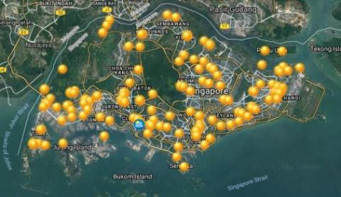
Project Sponsor
Singapore’s national institute for applied solar energy research
Is dedicated to research, development, testing and consulting on solar energy technologies and their integration into power systems and buildings
is globally active but focuses on technologies and services for tropical regions, in particular for Singapore and South-East Asia
is jointly sponsored by Singapore’s National Research Foundation (NRF) - via the Singapore EDB, and NUS
Campus located at NUS
National Solar Repo. of SG

Slide 5

Project Objectives
Real-time Analytical Monitoring Application
To develop a cloud based platform for integrating and managing real-time analytical monitoring of PV systems performance
Cloud Platform: An integrated cloud platform to support and meet the application's requirements
Web portal: A web portal for users to access the application components
Data Engineering & Visualization: A cloud based application that can record, transform and report the data sent from PV systems

Slide 6

Requirements Overview
A Web portal – A web portal for users to access the application components
User Management
Device and Station configurations
Report configuration
Central Data Engineering – A cloud based application that can record, transform and report the data sent from PV systems.
Data Capture – Cloud based components that captures and records the incoming data (unstructured) sent from sensors
Transformation – Cloud based components that transform and records the unstructured data into structured data for further analytics and reporting purposes
Data Visualization – Cloud based visualization component that performs back-end analytical calculations and make it available for front-end visualization

Slide 7
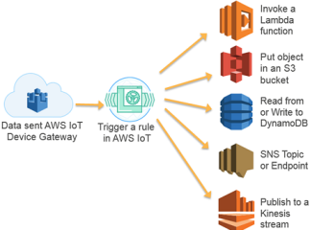
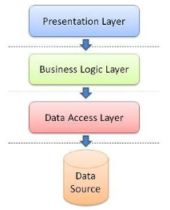
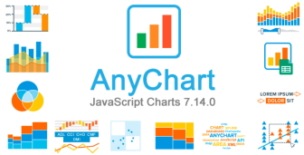
Architecture & Technologies Used (Recap)
AWS IoT Landscape
AWS Lambda
Dynamo DB
AWS S3
AWS Kinesis
AWS Containers
Backend Web-Service API
Front-end web application
Chart Libraries

Slide 8
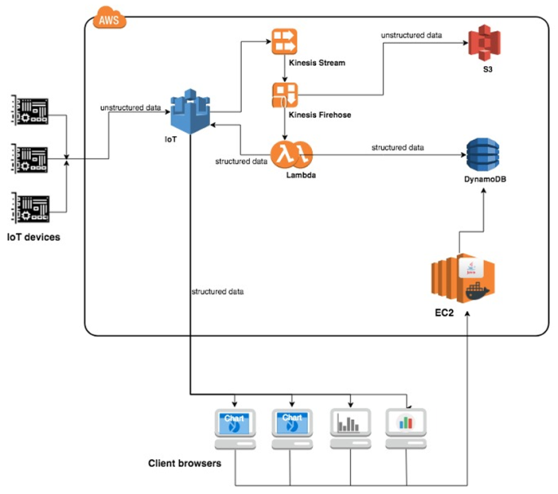
High Level Design (Recap)

Slide 9

Prototype (Recap)
Phase – I
Windows acting as a device (Simulation)
Sending data to IoT Core
Subscribe to MQTT topic
Extract and Display the transmitted msg
Configure rules in AWS IoT to Trigger lambda fn()
Invoke a lambda function
Message Persistence in dynamoDB
Stores these messages into dynamoDB
Phase – II
lambda sends message back to IoT core
IoT core captures the message sent by lambda

Slide 10
Project Effort Estimation (Recap)
Use Case Point Estimation
Unadjusted Use Case Point (UUCP) | Total Weight (Actors + UseCases) 16 (actors) + 130 (use cases) 146
Use Case Point (UCP) | UUCP x TCF x EF 146 * 1.02 * 0.89 132.54
Effort (man days) | UCP x ISS_Productivity_Factor 132.54 * 17 2,253 man hours; i.e. 282 man days
TCF – Technical Complexity Factors →1.02 EF – Environmental Factors → 0.89

Slide 11
Project Timeline (Recap)
Phase / Timeline | Jan 2018 | Feb | Mar | Apr | May | Jun | Jul | Aug | Sep | Oct | Nov | Dec 2018 | Jan 2019
Increment 0 |  |  |  | 7
Increment 1
Increment 2
Initial Planning
Requirements Engineering
Requirements Analysis
Analysis and Design
Dev. (Env. Setup & Coding)
SIT
*Training & UAT
SAD
2 - May
Development
SIT
UAT
#
@
*Training – Train the trainer # – Training @ – Handover
11

Slide 12
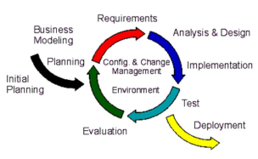
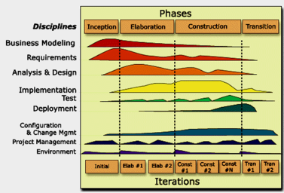
Incremental Development Strategy
RUP (Rational Unified Process) Methodology
RUP and Iterative Development
Planning & Feasibility
Increment 1 & 2
Planning and Feasibility
Planning
Requirements & Scoping
Use Case Model & Estimation
Software Architecture
High level Design
Proto-typing

Slide 13
Increment 1 Development Phase
Increment 1 (Current Phase)
Requirements Modeling
Revisit design & architecture
Transition Strategy
Design Modeling
Testing Strategy

Slide 14
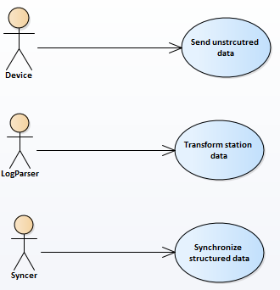
Use Case Model (Iteration-1, current phase)
Device:
Send Un-Structured data
LogParser:
Transform station data
Syncer:
Synchronize un-structured data

Slide 15
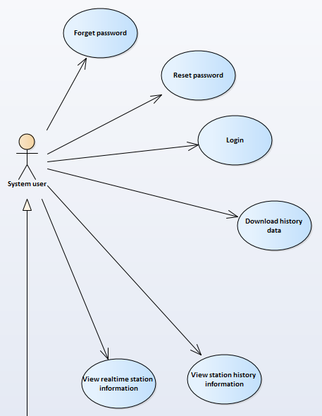
Use Case Model (Iteration-2, next phase)
System User
Forgot password
Reset password
Login
View real-time station info.
View station history info.
Download history data

Slide 16
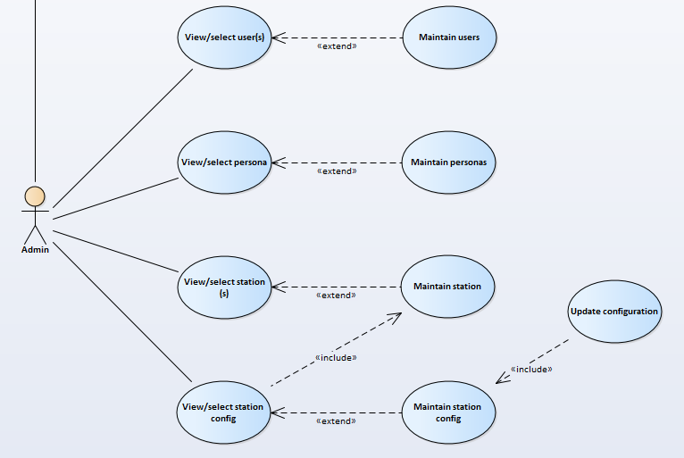
Use Case Model (Iteration-1, current phase)
Admin
View/Select
Users
Station
Station Config.
Extend Use-Case(s)
Maintain Users
Maintain Station
Maintain Station Config
Update Station Config

Slide 17
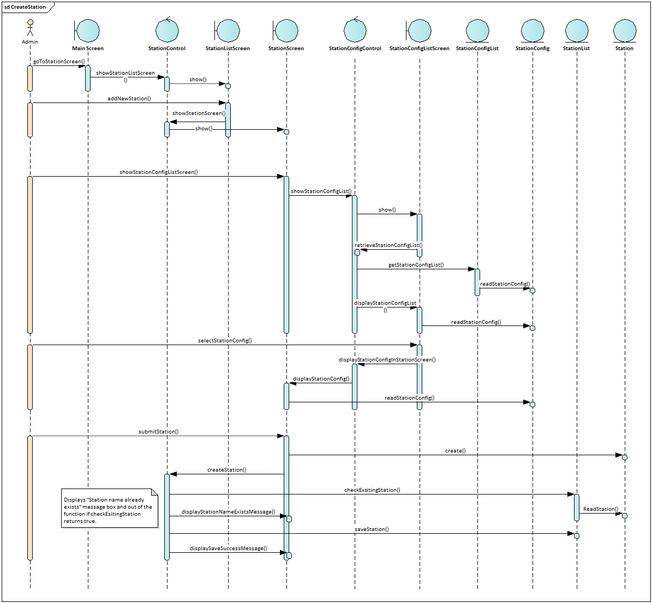
AM Sequence Diagram
Focus on ‘what’
Maintain Station
Create Station

Slide 18
Focus on ‘how’
Basic 3-tiers architecture
2 different projects (font-end and back-end)
Identifying design classes
Packaging classes
Identifying Package dependencies
Identification of Reuse Opportunities

Slide 19
Mapping packages (from AM to DM)
Basic 3-tier architecture | AM | DM front-end | DM back-end
Presentation | Screens | Components Router
Business Logic | Controller | Action Creators Reducers Store APIs | API Controllers Services
Data access | Entity List Entity |  | Repository Entity

Slide 20
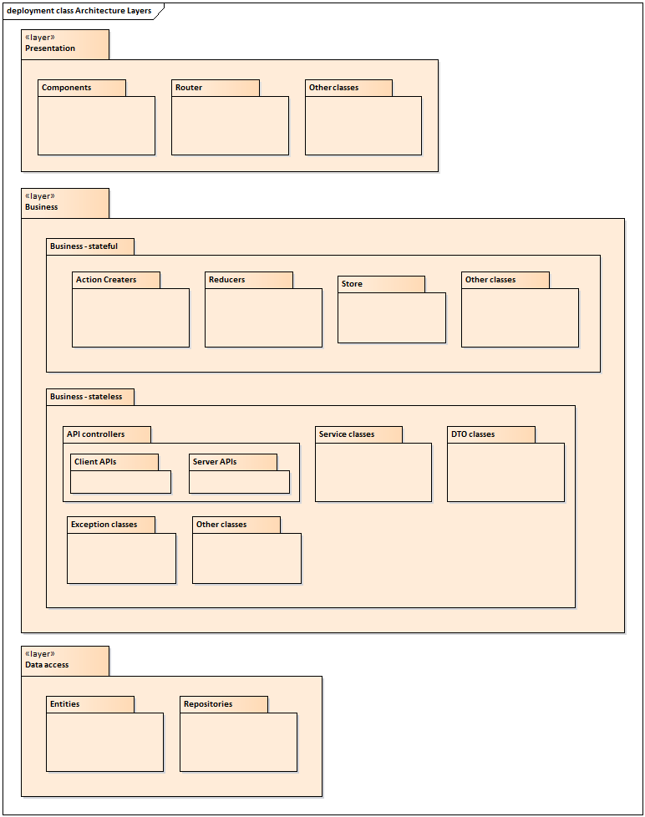
Packages diagram

Slide 21
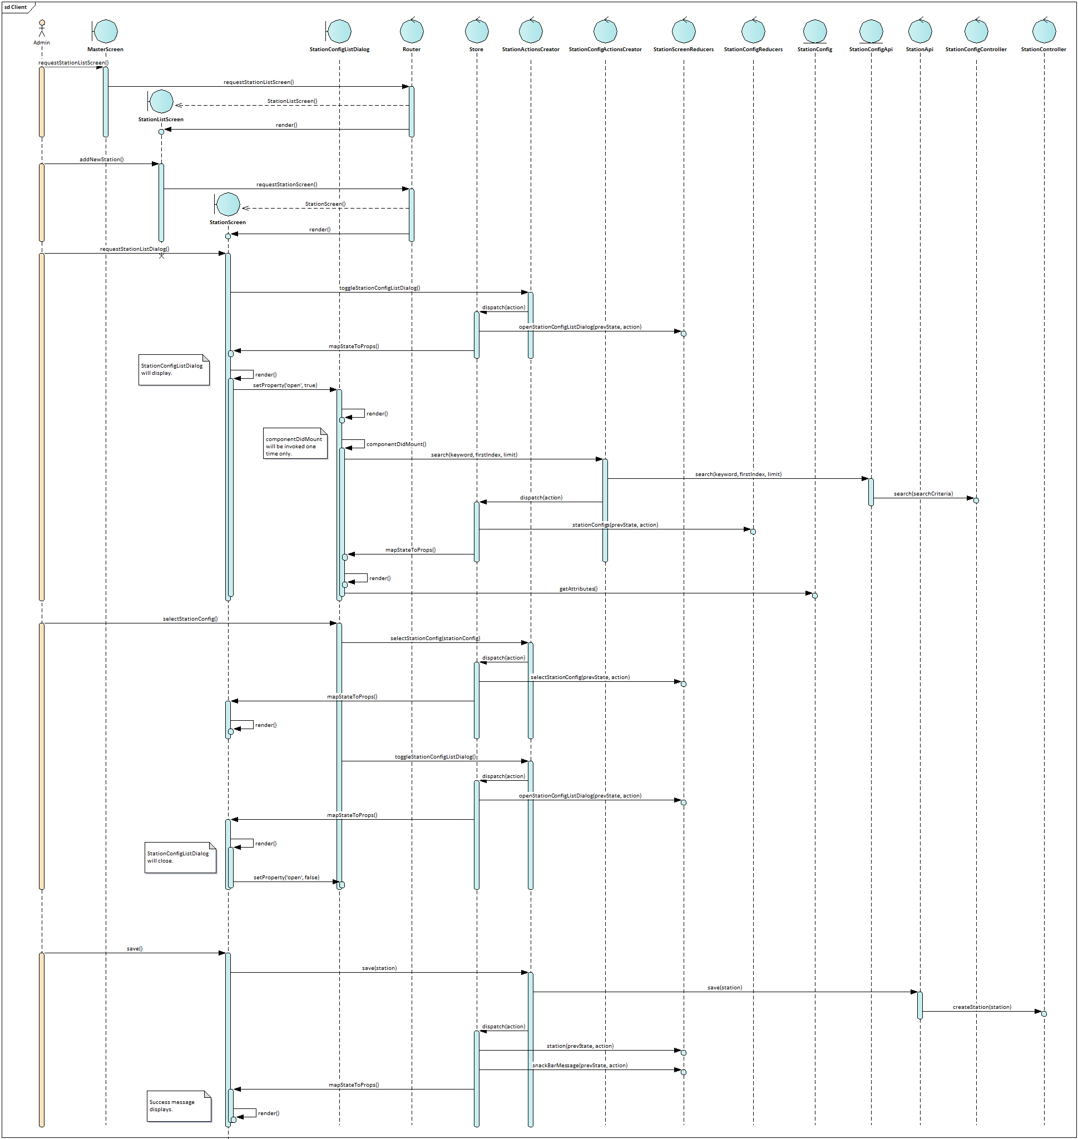
DM – Client Sequence Diagram

Slide 22
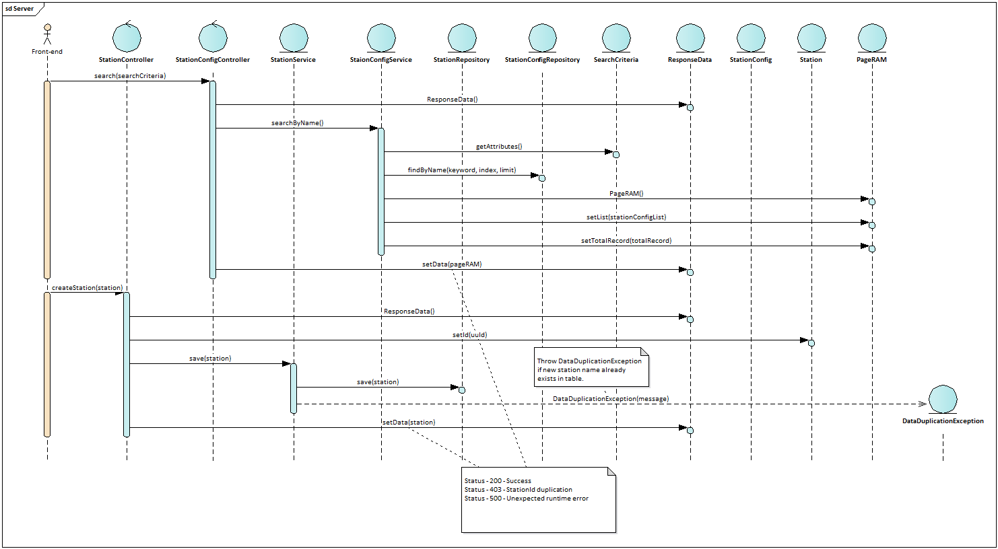
DM – Server Sequence Diagram

Slide 23

Transforming raw data into structured data
120,8,1,2011-04-19T03:44:01.103Z,0,1000,900,90,14,250,27,40,500
121,8,1,2011-04-19T03:44:01.103Z,0,250,27,40,500
{
"softwareType": 8,
"windSpeed": 14,
"recordId": 1,
"@version": "1",
"irradiance": 900,
"timestamp": "2011-04-19T03:44:01.103Z",
"pyranometer": 1000,
.
.
.
"activePower": 500,
"ambientTemperature": 27
}
Input
Output
0 – stationId
1 – softwareType
2 – activePower
Transform
Parameters Configuration

Slide 24
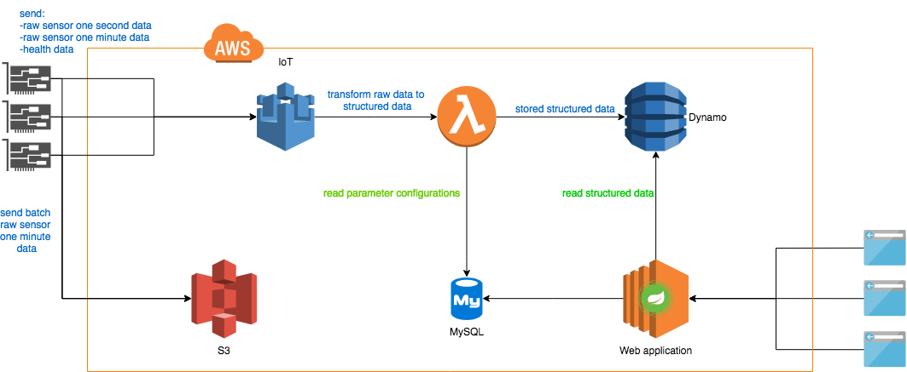
Overall architecture (as of May)

Slide 25
Challenges & problems
Lambda is a function; can not buffer configuration in memory for future use
Hitting MySQL database to get the related parameters configuration every time when a new raw data is coming-in
Developer has to write codes in AWS Lambda
For transforming raw data into structured data &
For storing structured data into NoSQL database.
Needs to enhance/modify the source code
to create a pair of tables when a new incoming data (one-second, one-minute and health is sent from device)

Slide 26
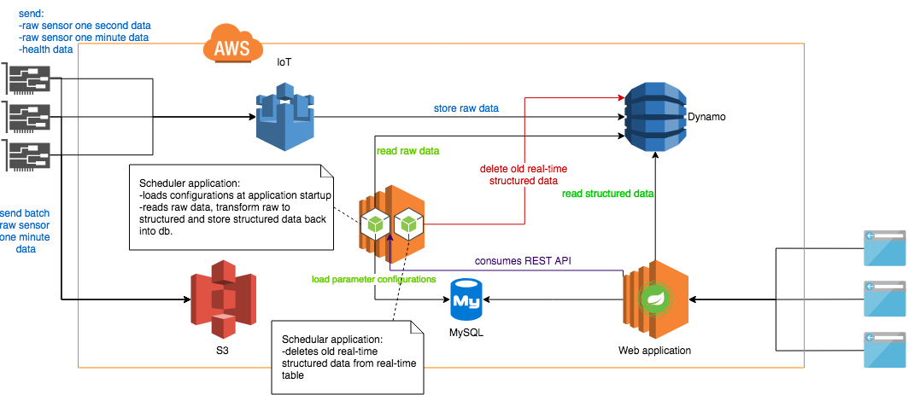
Revised architecture

Slide 27
Challenges & Problems
Scheduler application is to be developed from scratch for transforming raw data to structured data.
Application will load station parameter configurations when it starts and stores in the memory
but API must be developed for the web application to update the configurations in memory
Another lightweight scheduler application to be developed from scratch
for deleting one-second and one-minute records (Old records, one or two days old)
from real-time table in database to reduce the reading performance on database table.
Source codes for both scheduler applications need to be maintained by the client after the project.
Needs to enhance/modify the source code
to create a pair of tables when a new incoming data( not one-second, one-minute and health) is sent from device.

Slide 28
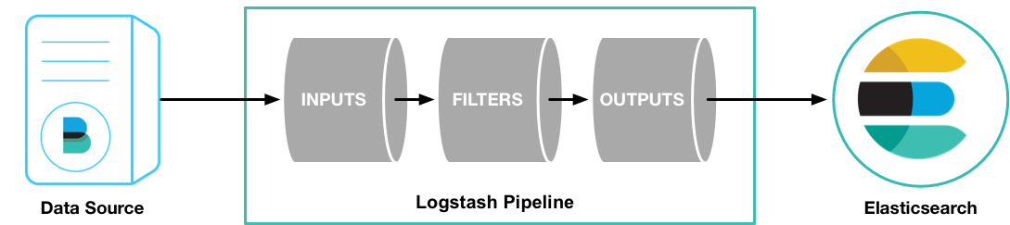

Solution – Logstash
Centralize, Transform & Stash Data
Logstash is an open source, server-side data processing pipeline
Ingest data from a multitude of sources simultaneously
Transforms it, and then sends it to your favourite “stash” - i.e. Elasticsearch

Slide 29
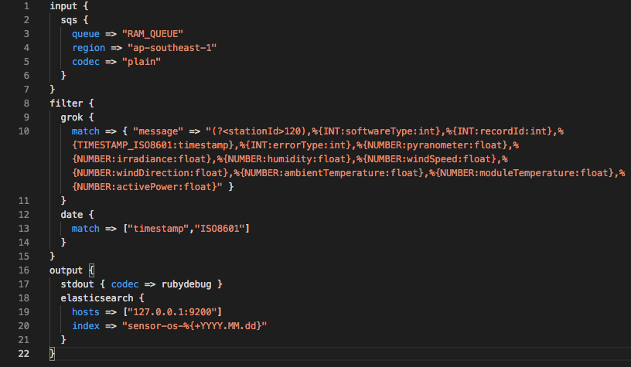
Logstash – Pipeline Configuration
Input – Amazon SQS
Filter – Grok
Output – Elasticsearch

Slide 30
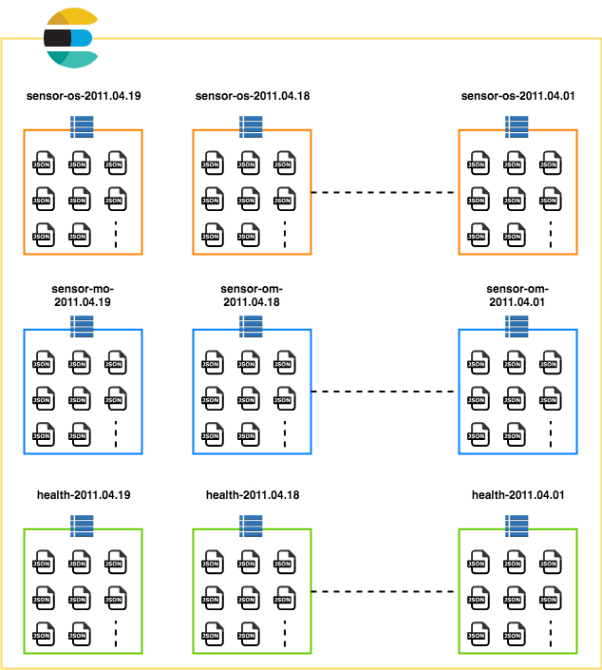
Elasticsearch Indices
Indices will be created by daily basis
Documents will be mapped in relevant index based on it’s timestamp
Latest index will always be used for real-time visualization
Timestamp inside the incoming data must be UTC-ISO8601 format. E.g. 2011-04-19T03:44:01.103Z

Slide 31
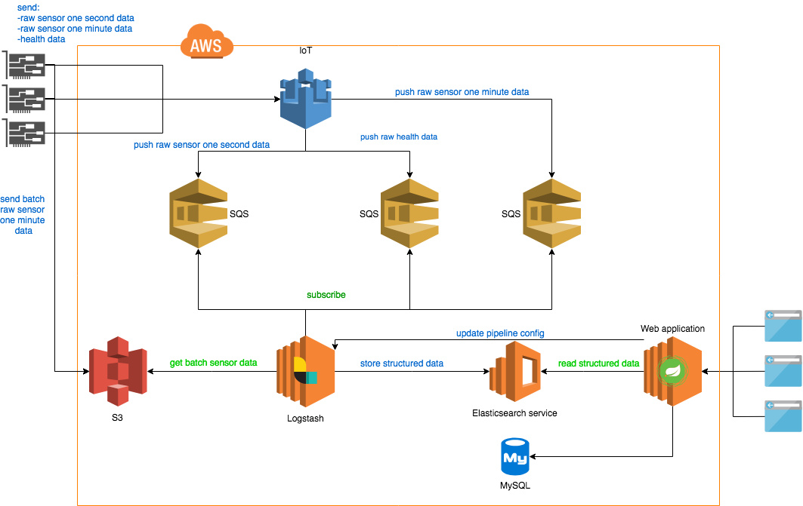
High Level Architecture

Slide 32
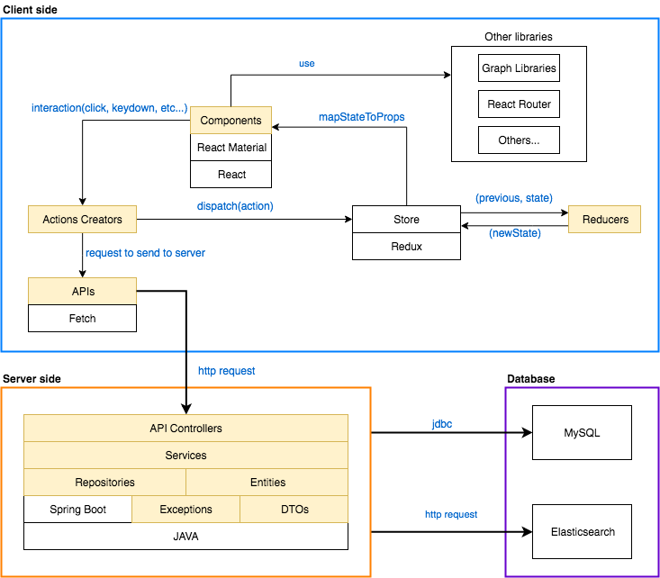
Web App. Arch.

Slide 33
Major modules
Receiving and buffering incoming raw data
One second sensor data
One minute sensor data
Health data
Transforming incoming raw data into structured data
Visualization of structured data

Slide 34
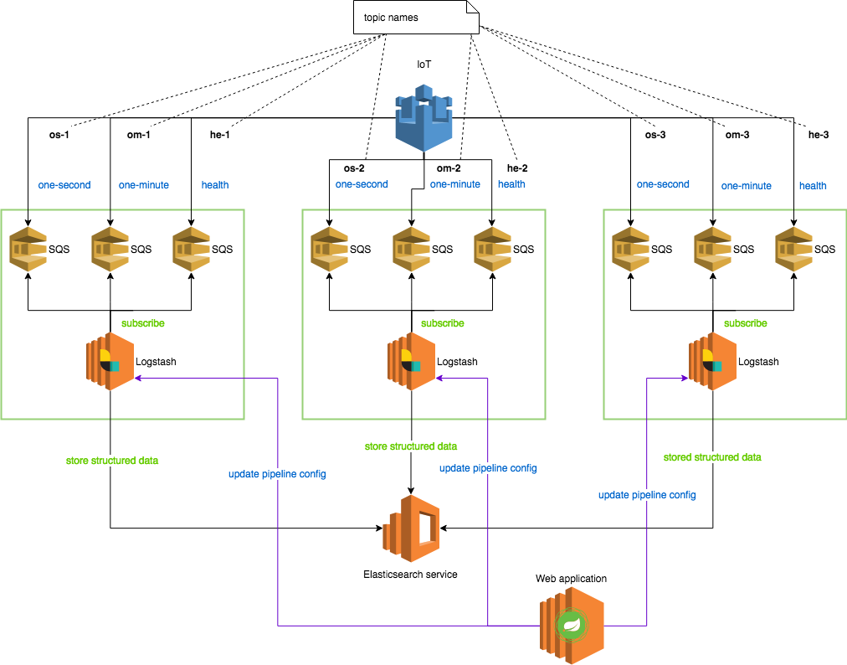
Horizontal Scaling

Slide 35
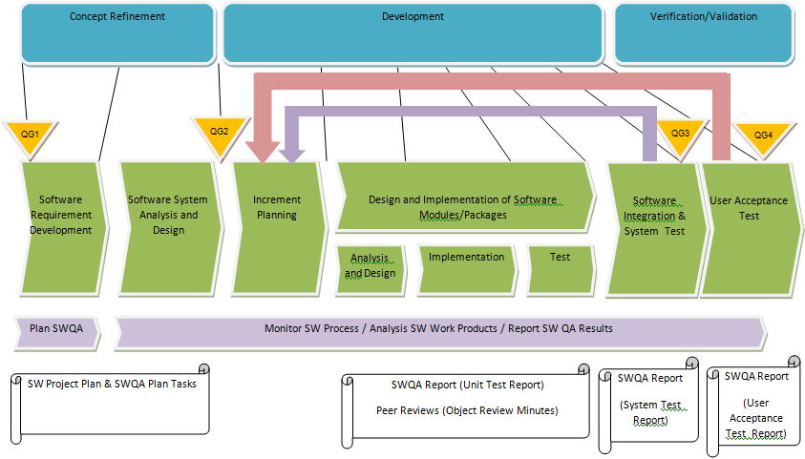
Quality Management Process

Slide 36
Software Testing
Module Test/Unit Test
Module or Package level/unit test will be performed.
Functionality check will be performed according to specifications and it has to fulfil
respective package/module’s requirements.
Integration and System Test
Integration test is next level after having successfully finished module/unit test.
This test is to check interfaces between respective modules when integrating each module.
communication between modules, their functionalities and interactions must be checked.
Software System Test is the next level after having successfully finished the integration test.
The purpose of the Software System Test is to test the integrated software that will satisfy the software
requirements. The focus is the functionality of the software system. The software system test has to be
performed.
To complete the Software System Test, test must be performed based on Test Cases derived from
customer requirements.
User Acceptance Test
This test basically needs to fulfil user requirements and prove that the software system works according
to its requirement specifications.
Together with customer ,user acceptance test will be carried out to verify that agreed user requirements are
met and get customer’s approval.

Slide 37
Software Testing (Cont.)
Customer Required Tests
Special tests required by the customer to verify specific issues.
Often the test specifications for these tests are written by the customer, refer them in related documents.
Regression Test
Consider regression testing (renewed testing in the future changes to verify that modifications have not caused unintended effects and that the software still complies with the requirements):
Reuse all test information as much as possible.
Due to budget, time and resource limitations, it is often necessary to define a strategy for selecting an adequate subset of tests for retesting.
It is always necessary to check the test specification if
new test cases have to be defined
existing test cases have to be modified
existing test cases have to be added
to ensure an adequate test coverage. After major changes , it is necessary to check the test plan as well.
Define a suitable regression test strategy considering the different test levels. Use the test case priorities to define an appropriate regression test scope . Ensure that at least all priority 1 test cases have to be executed
for one regression test cycle.

Slide 38
Project Status (Timeline)
2 - May
29-Aug
Phase / Timeline | Jan 2018 | Feb | Mar | Apr | May | Jun | Jul | Aug | Sep | Oct | Nov | Dec 2018 | Jan 2019
Increment 0 |  |  |  | 7
Increment 1
Increment 2
Initial Planning
Requirements Engineering
Requirements Analysis
Analysis and Design
Dev. (Env. Setup & Coding)
UT
SIT
SAD
Development
SIT
*UAT
#
@
*Training – Train the trainer # – Training @ – Handover
38

Slide 39
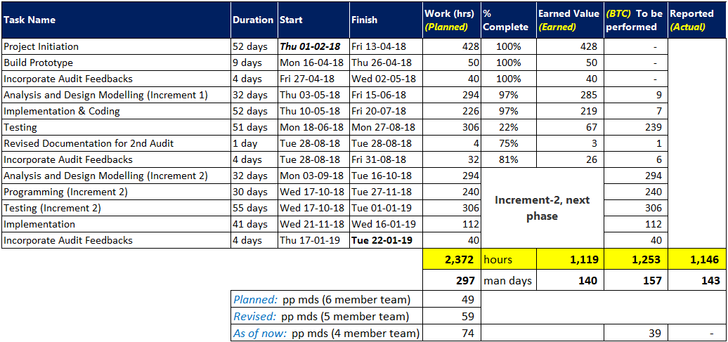

Project Status (Control, Tracking and Reporting)

Slide 40
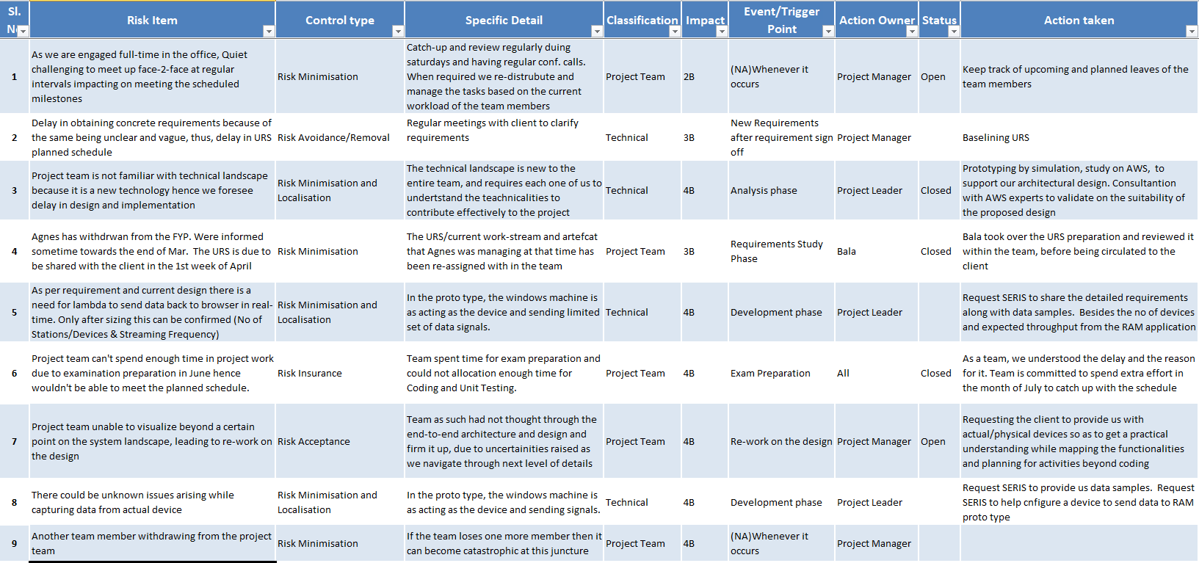
Risk Register

Slide 41


Q & A

Slide 42





Thank you
What’s Your Message?

Slide 43
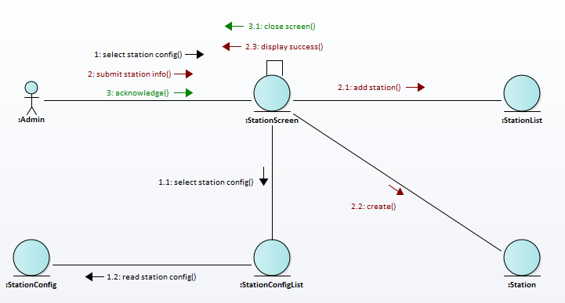
Create Station – Communication Diagram
User (Admin) selects ‘Create Station’, station details are input
Selects the ‘Station Config’, the station is mapped to the selected station configuration
User acknowledge the details, the station is successfully created
The corresponding station details are recorded

Slide 44
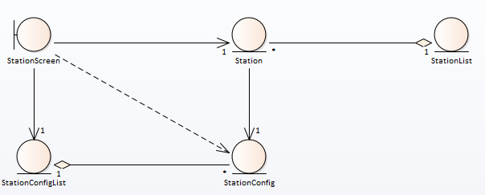
Maintain Station Use Case – Class Diagram

Slide 45
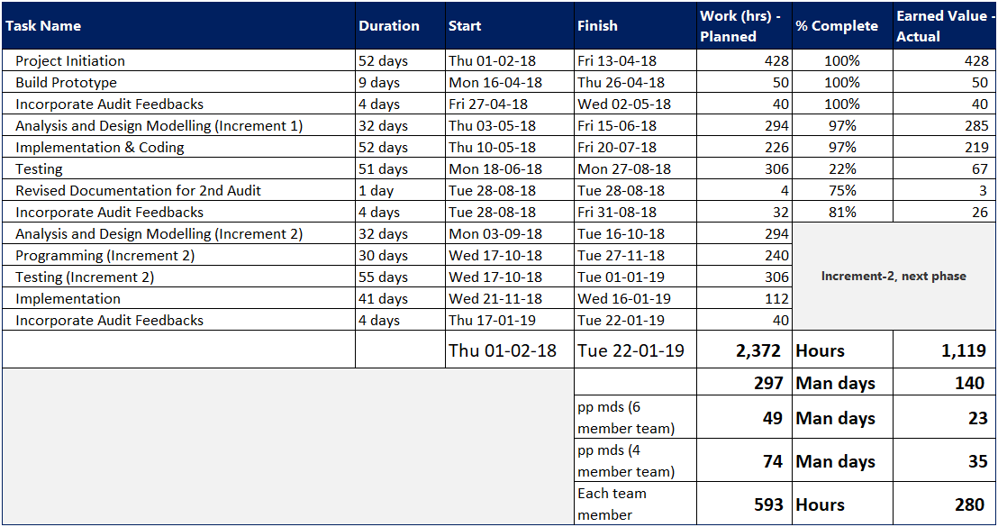
Project Effort

Slide 46
Technical Issues/Problems

Slide 47
Create Station

Slide 48
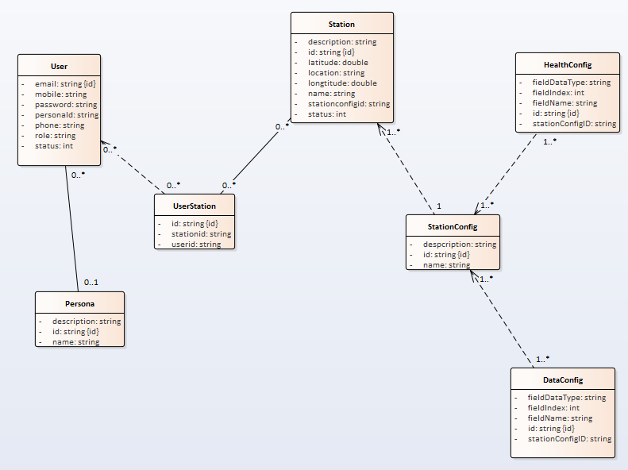
Entity Diagram

Slide 49
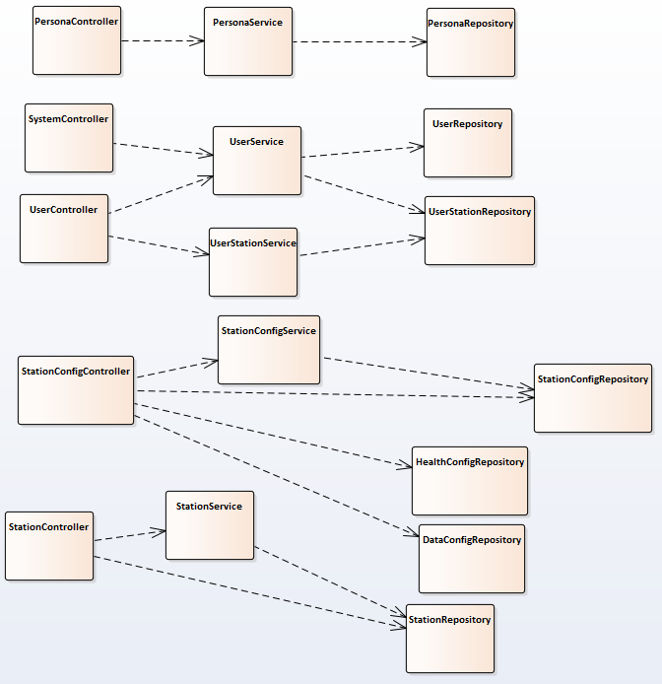
Class Diagram

Slide 50
Deliverables and Increments
Planning & Feasibility Phase | Increment 1 Development Phase | Increment 2 Development Phase
Project Plan Quality Plan User Requirements Specification (URS) Use Case Model Survey (UCMS) Prototyping Study Report High-Level Design Spec | Requirements Model Report High-Level Design Spec(revised) Design Model Report System Test Documentation Acceptance Test Documentation Project Plan (revised) User Guide | Requirements Model Report (finalized) High-Level Design Spec(finalized) Design Model Report (finalized) System Test Doc (finalized) Acceptance Test Doc (finalized) User Guide (finalized) Final System End of Project Report

Slide 51
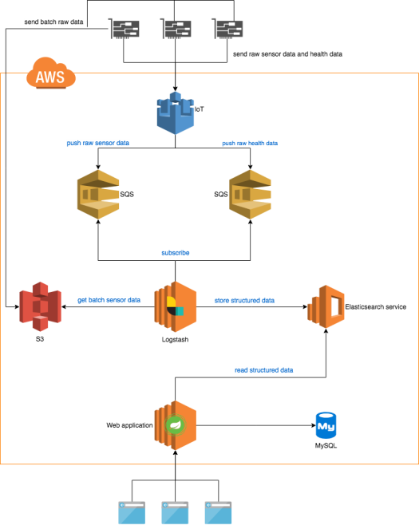
Software Architecture
Send raw data to IoT
Push raw data into logstash using SQS
Transform into structured data
Raw data: S3
Stru. data: ESS
Web App access data via ESS & mySQL

Slide 52
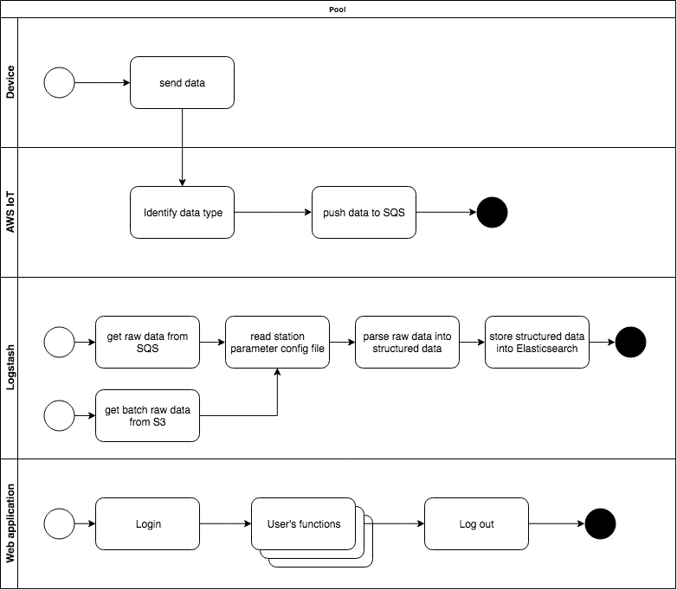
Software Architecture
Receiving raw data
Parsing raw data into structured data
Web application for visualization

Slide 53
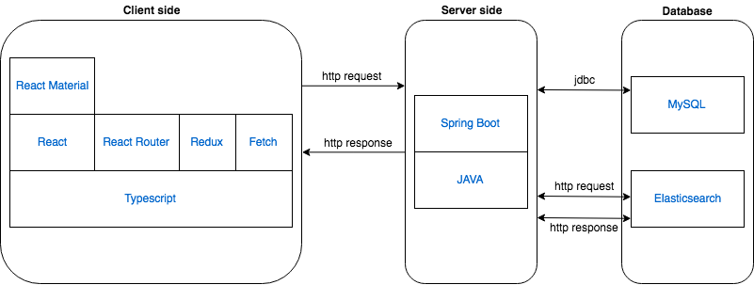
Software Architecture
Presentation layer
Business Layer
Data Access Layer
Notes:
Presentation Layer: will be implemented with React.
Business Layer: Java back-end application which has business process handlings and expose as REST web services. Spring Boot framework will be used for back-end.
Data access Layer: will be implemented using JPA-Hibernate and http request/response.

Slide 54
Agenda – ISS Expectation (Hidden Slide)
A brief introduction to the project (to remind us of the requirements).
A brief recap of your Use Case Model Global View, incremental development strategy and software architecture.
Optional discussion of your Analysis of one key use case.
Discussion of your Transition Strategy from analysis to design.
Discussion of the technical issues/problems that were encountered during the Increment 1 Development Phase, including a description of your solutions.
If time allows, brief demonstration of your Increment 1 Release.
Discussion of the System Testing performed and Acceptance Process that you have completed (or plan to undertake) to achieve user/customer acceptance of the Increment 1 Release, including any results, customer feedback etc.
Report on overall project progress against the plans (planned versus actuals), including a discussion of reasons for differences. You should present progress in terms of both man-day effort and schedule, and you should include discussion of any re-planning that has been necessary.
Discussion of management problems that occurred during the Increment 1 Development Phase of the project (such as the need to de-scope, loss of man-power, falling behind schedule etc), including a description of your solutions (appropriate links should be made to re-planning).
Discussion of your plans for the Increment 2 Development Phase.
When considering the content to be presented, do take note of the following:
Wherever applicable in the above items to be presented, do emphasize your added value by highlighting the use of novel/innovative management/technical techniques/approaches/considerations in dealing with challenges/issues that were encountered/anticipated. Do also highlight efforts where your team goes beyond what is normally expected of.
If your process varies from the regular incremental model, do make the necessary adjustment so that the presented content suitably reflects your progress and achievement.

Slide 55
Risk Item | Control type | Specific Detail
Project team member turnover | Schedule slippage and increased cost | N/A
Late response from client | Schedule slippage | shares the project schedule to client and mention the latest expected feedback
Late change in requirement spec from client | Schedule slippage and increased cost | Regular meetings with client to clarify requirements
Issue during system integration with external system | Schedule slippage and increased cost | Intensive study will be done
Delayed decision on payment vendor selection | Schedule slippage and increased cost | Intensive study will be done
Project team is not familiar with technology requested by client | Performance issue and increased cost | Training plan is created
Issue with software versioning and revision control | Schedule slippage | Synchronize working document among project team regularly
Technology Challenges
Developing hybrid application using React Native, React Native community is small for any support or help
FCM and other queuing techniques are new to the team

Slide 56
Problems Encountered & Resolution
Synapse direct involvement on deciding on tech scope, restricting the tech scope by various technical workshops
Social Dining scope, initial scope was not defined, various Requirement Analysis meeting with user to finalise and baselining URS
Payment vendor finalisation, team went ahead to evaluate payment options like Singapay and suggesting SingTel Dash payment

